Slide 1
Sensation and Perception
Lecture: Perceptual Constancy

Slide 2
Perceptual Constancy
Perceptual Constancy – the tendency to see properties of objects (e.g. color, motion, shape, size, orientation) as remaining stable, despite variable sensory input
Our conscious experiences of object properties (shape, size, color, lightness, orientation, position) are more closely correlated with the distal stimulus than the proximal stimulus
We perceive the constant unchanging properties of external objects rather than the transient properties of the retinal image

Slide 3
Necessity for Constancy Mechanisms in the Brain
If the only information we had about nature were the proximal stimulus, the retinal image of an object, our world would be chaotic
What would happen? It would be all about the retinal image
If no Size constancy People would seem to grow in size as they got closer and smaller as they got further away
If no Shape constancy The table in front of me would change shape continually
If no Orientation constancy The walls would look tilted as I move my head
If no Position constancy Objects would appear to change position when I move my eyes

Slide 4
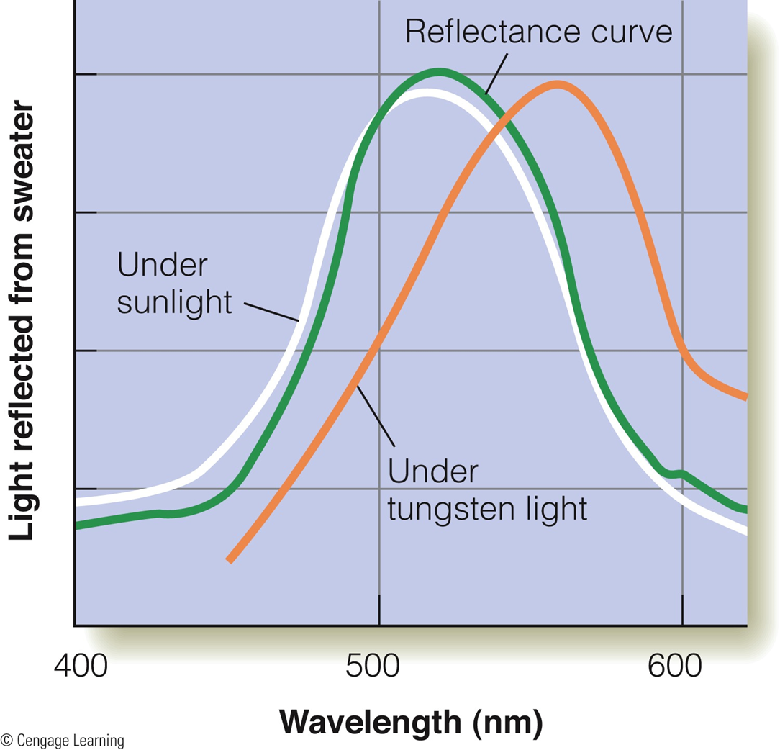
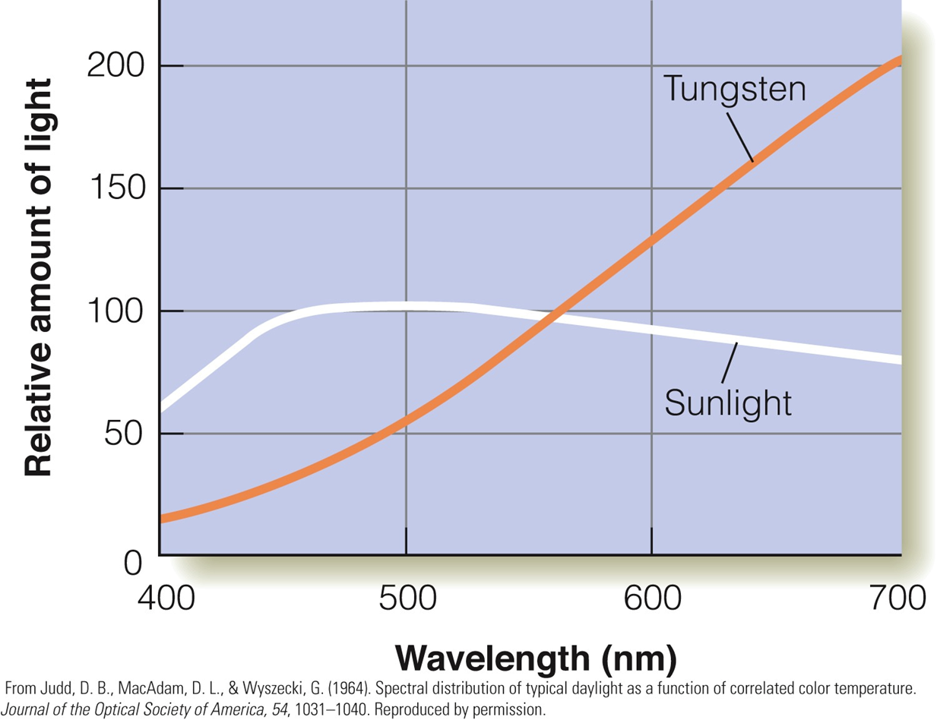
Color Constancy

Slide 5
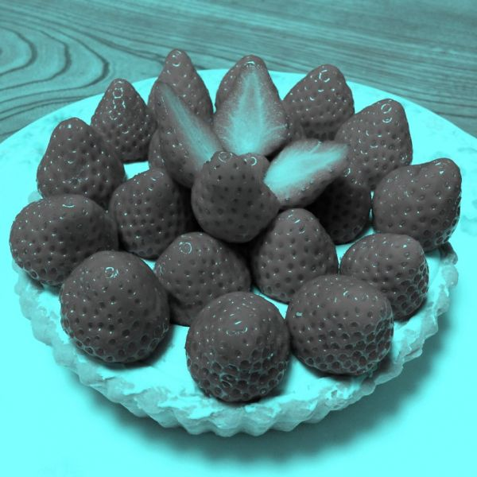
Color Constancy

Slide 6
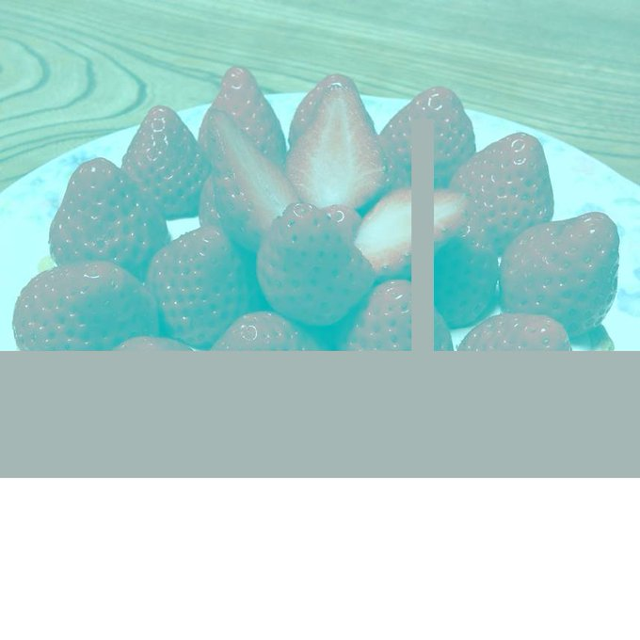
Color Constancy

Slide 7
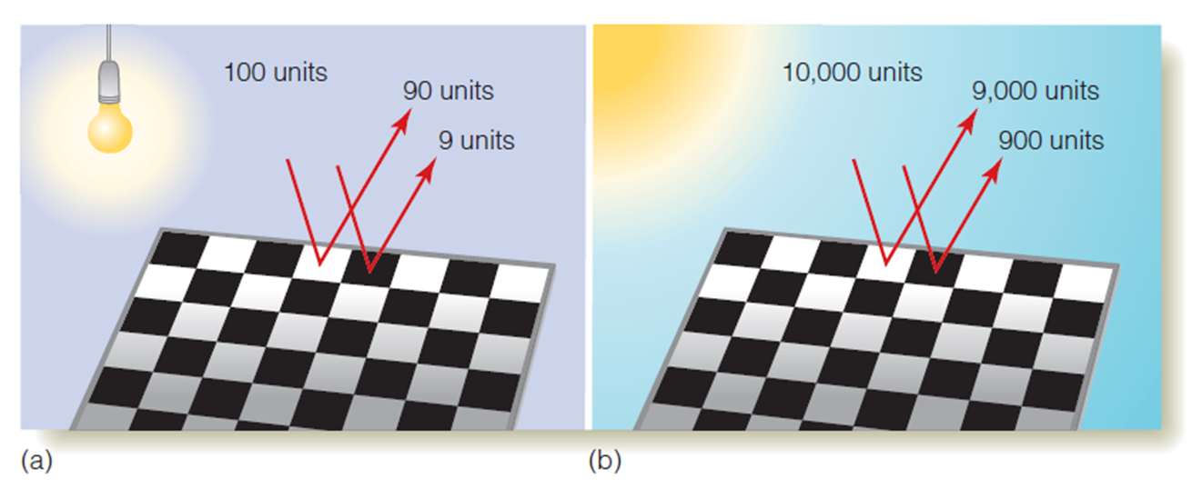
Lightness Constancy

Slide 8
Shape Constancy

Slide 9
Shape Constancy

Slide 10
Orientation Constancy
Our ability to perceive the world as upright and unchanging in orientation despite changes to the retinal image
Brain seems to be doing the following: O_{object} = O_{image} + O_{head}
Example: Lying on your sofa watching the TV

Slide 11
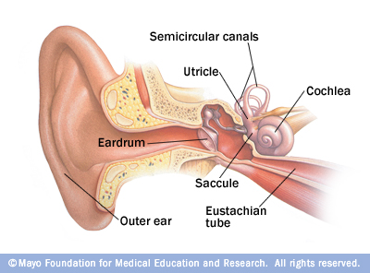
Orientation Constancy
Where does the brain get information from to compute orientation?
Gravity
Where from: pressure on skin; vestibular system (utricle and saccule, and semicircular canals)
Visual Information – we know that walls are aligned with gravity and floors and ceilings perpendicular

Slide 12
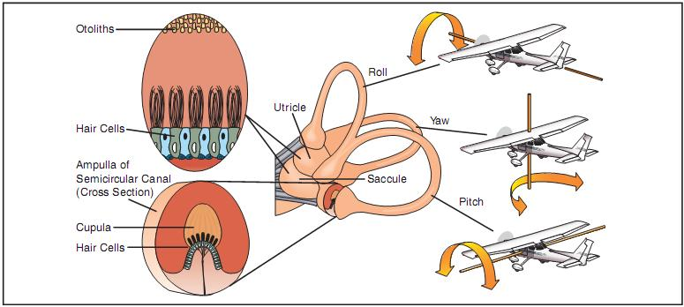
Orientation Constancy
Utricles detect linear acceleration in the horizontal plane
Saccules detect linear acceleration in the vertical plane
Sprinting down a track?
Going up in an elevator?
Tilting head?
Semicircular canals

Slide 13
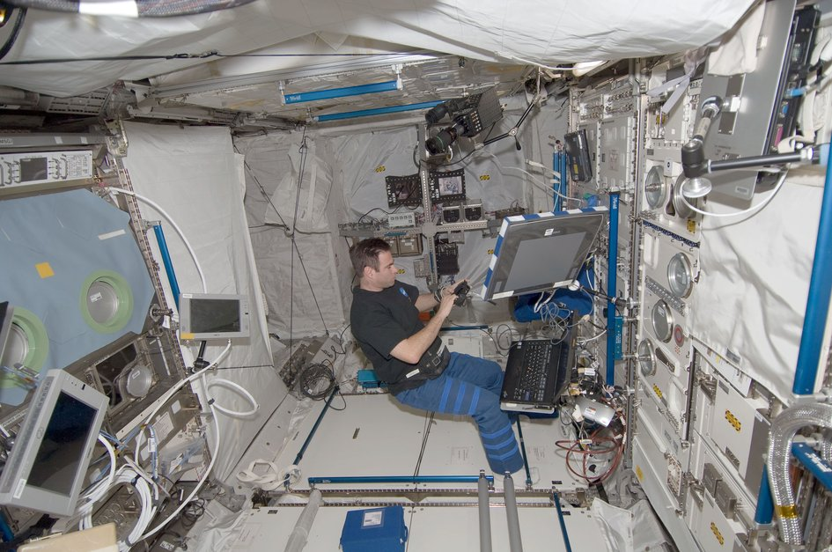
Orientation Constancy: What happens when the gravity cue is absent?
Visual Orientation Illusions
Can we get information from vestibular system?
Any information from pressure on skin?
What cues do astronauts rely on to know what is up and down?
(Lacker & DiZio (2000). Human orientation and movement control in weightless and artifical gravity environments)

Slide 14
Orientation Constancy: What happens when the gravity cue is absent?
The brain creates a frame of reference (up, down, left, right, top, bottom) defined by the orientation of labeled racks and panels in the spaceship.
However, astronauts report that they experienced disorientation: under two conditions:
1) when working upside down – whatever surface was next to their feet seemed like the floor; overhead surfaces were perceived to be ceilings; surfaces parallel seemed to be walls

Slide 15
Orientation Constancy: What happens when the gravity cue is absent?
or
2)when floating right side up and viewing another crewmember floating upside down in the cabin
In this case, the orientation of the inverted crewmember determined the direction to the “floor”
Important – in both cases, it was as if an internal mental coordinate frame responsible for perception of up, down, etc had rotated to a new orientation determined by available visual cues

Slide 16
Size Constancy

Slide 17
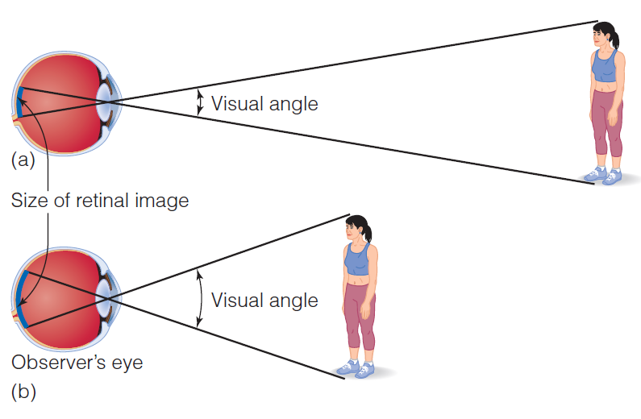
Perceiving Size

Slide 18
Size Constancy
Perception of an object’s size remains relatively constant.
This effect remains even if the size of the retinal image changes.
Size-distance scaling equation
  S = K (R X D)
  The changes in distance and retinal size balance each other.
Notes:
18

Slide 19
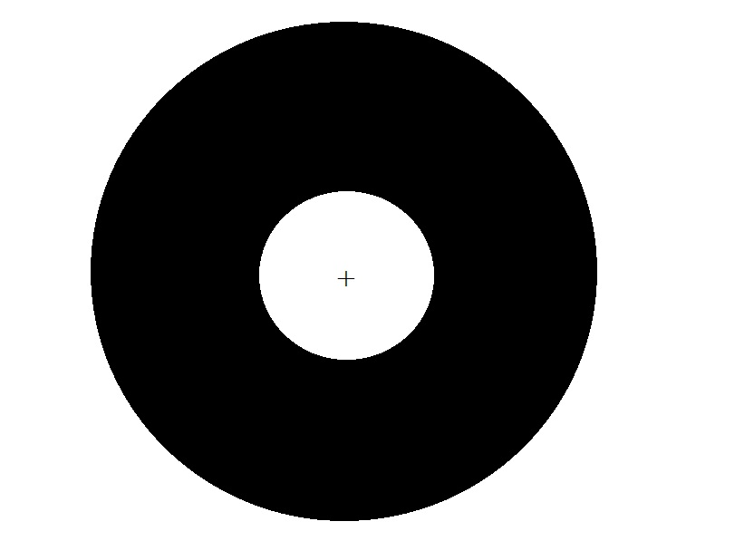
Size Constancy (cont'd.)
Emmert’s law:
  Retinal size of an afterimage remains constant.
  Perceived size will change depending on distance of projection.
  This follows the size-distance scaling equation.
Notes:
19

Slide 20
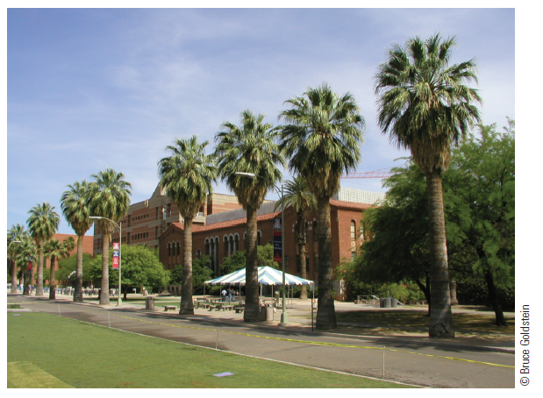
Size Constancy (cont'd.)
Notes:
20
Figure 10.35 All of the palm trees appear to be the same size when viewed in the environment, even though the farther ones have a smaller visual angle.

Slide 21
Visual Illusions
Some illusions can be explained by the connection between the perception of size and the perception of depth.
The Müller-Lyer illusion
  Straight lines with inward fins appear shorter than straight lines with outward fins.
  Lines are actually the same length.
Notes:
21

Slide 22
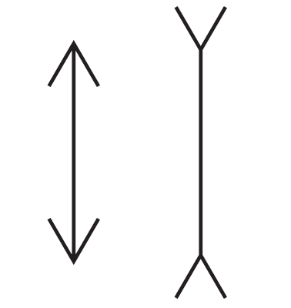
Visual Illusions (cont'd.)
Notes:
22
Figure 10.39 The Müller-Lyer illusion. Both lines are actually the same length.

Slide 23
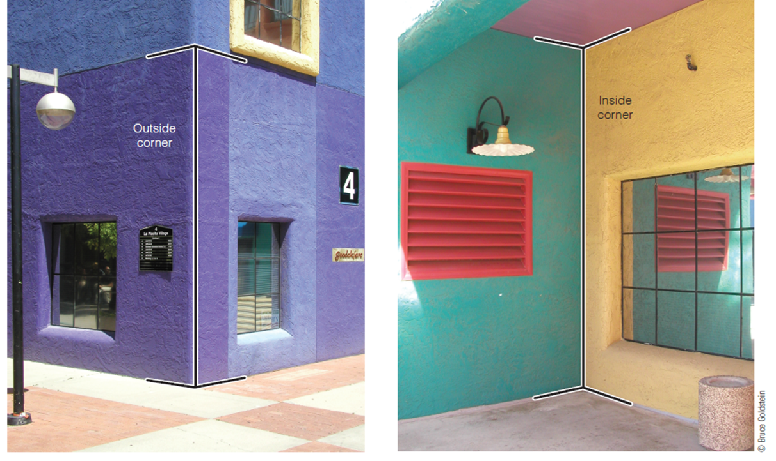
The Müller-Lyer Illusion
Why does this illusion occur?
  Misapplied size-constancy scaling:
    Size constancy scaling that works in 3-D is misapplied for 2-D objects.
    Observers unconsciously perceive the fins as belonging to outside and inside corners.
    Outside corners would be closer and inside corners would be further away.
Notes:
23

Slide 24
The Müller-Lyer Illusion (cont'd.)
Explanation:
  Since the retinal images are the same, the lines must be different sizes.
Problems with this explanation:
  The “dumbbell” version shows the same perception even though there are no “corners.”
  The illusion also occurs for some 3-D displays.
Notes:
24

Slide 25
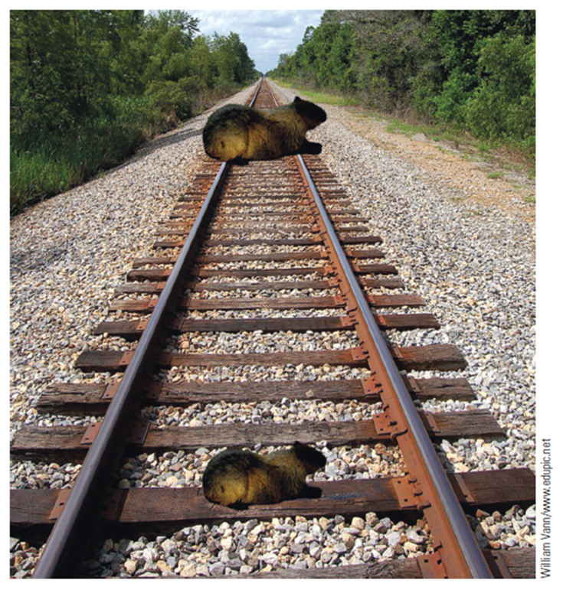
The Ponzo Illusion
Horizontal rectangular objects are placed over railroad tracks in a picture.
The far rectangle appears larger than the closer rectangle but both are the same size.
One possible explanation is misapplied size-constancy scaling.
S = R x D
Notes:
25

Slide 26
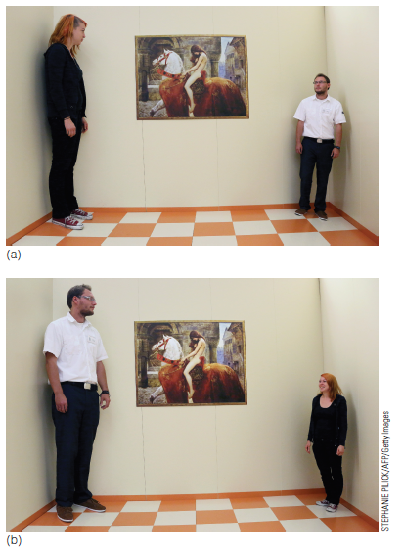
The Ames Room
Notes:
26
Figure 10.45 The Ames room. Although both people are about the same height, (a) the woman appears taller or (b) the man appears taller because of the distorted shape of the room.

Slide 27
The Ames Room (cont.)
People are equal size, appear very different
The room is constructed so that:
  The shape looks like a normal room when viewed from a particular observation point
  The right corner is twice as far from the observer as the left corner
Notes:
27

Slide 28
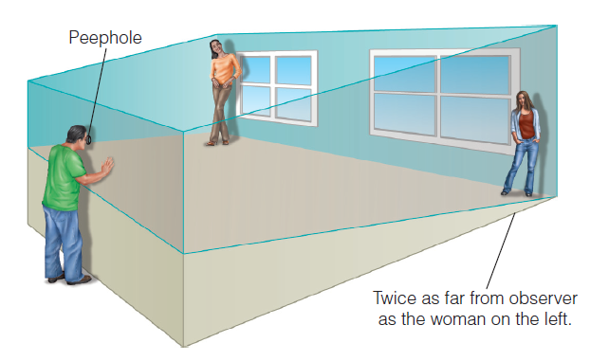
The Ames Room (cont'd.)
Notes:
28
Figure 10.46 The Ames room, showing its true shape. The person on the right is actually almost twice as far away from the observer as the person on the left; however, when the room is viewed through the peephole, this difference in distance is not seen. In order for the room to look normal when viewed through the peephole, it is necessary to enlarge the right side of the room.

Slide 29
The Ames Room (cont'd.)
One possible explanation: size-distance scaling
  Observer thinks the room is normal.
  Expectation that women are at same distance
    perceived distance (D) is the same for the women
    size of the retinal image (R) is smaller for one woman
  We perceive the one with the smaller visual angle as shorter (S = R x D).
Notes:
29

Slide 30
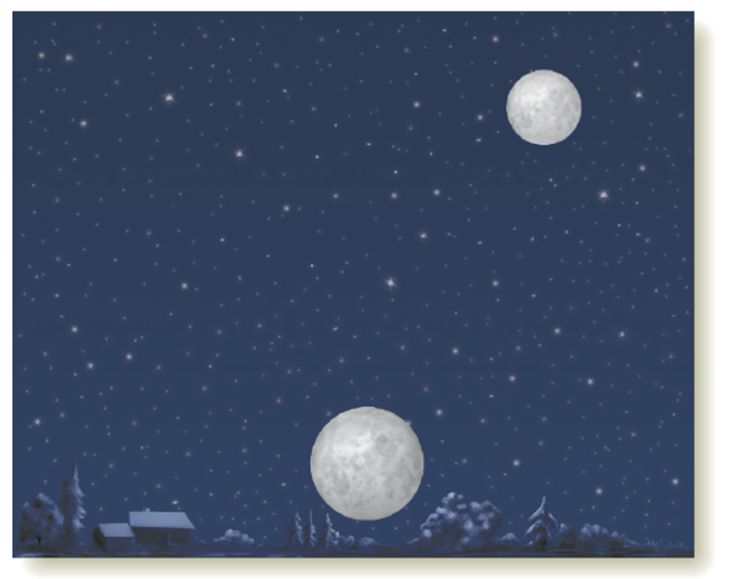
The Moon Illusion
The moon appears larger on the horizon than when it is higher in the sky.
One possible explanation:
  Apparent-distance theory: horizon moon is surrounded by depth cues while the moon higher in the sky has none.
  The horizon is perceived as further away than the sky, and called “flattened heavens”.
Notes:
30

Slide 31
The Moon Illusion (cont'd.)
Explanation:
  Since the moon in both cases has the same visual angle, it must appear larger at the horizon.
Another possible explanation:
  Angular size-contrast theory: the moon appears smaller when surrounded by larger objects.
  Thus, the large expanse of the sky makes it appear smaller.
Actual explanation may be a combination of a number of cues.
Notes:
31
Other factors are: atmospheric perspective, color, and oculomotor cues.

Slide 32
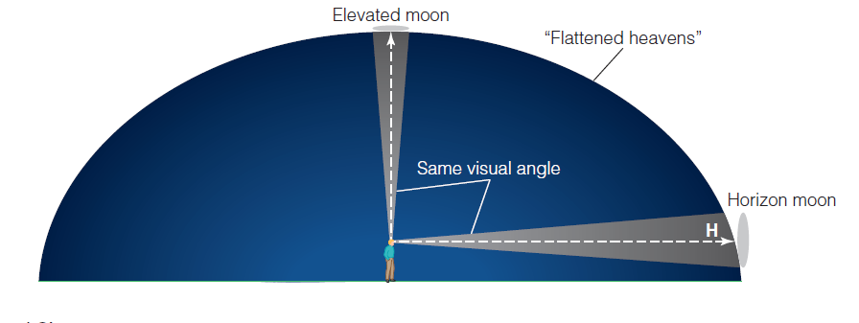
The Moon Illusion (cont'd.)
Notes:
32
Figure 10.48 When observers are asked to consider the sky as a surface and to compare the distance to the horizon (H) with the distance to the top of the sky on a clear moonless night, they usually say that the horizon appears farther away. This results in the “flattened heavens” shown here.

